Slide 1
Project Name : ZilaVikasManch Database Name : zvm

Slide 2
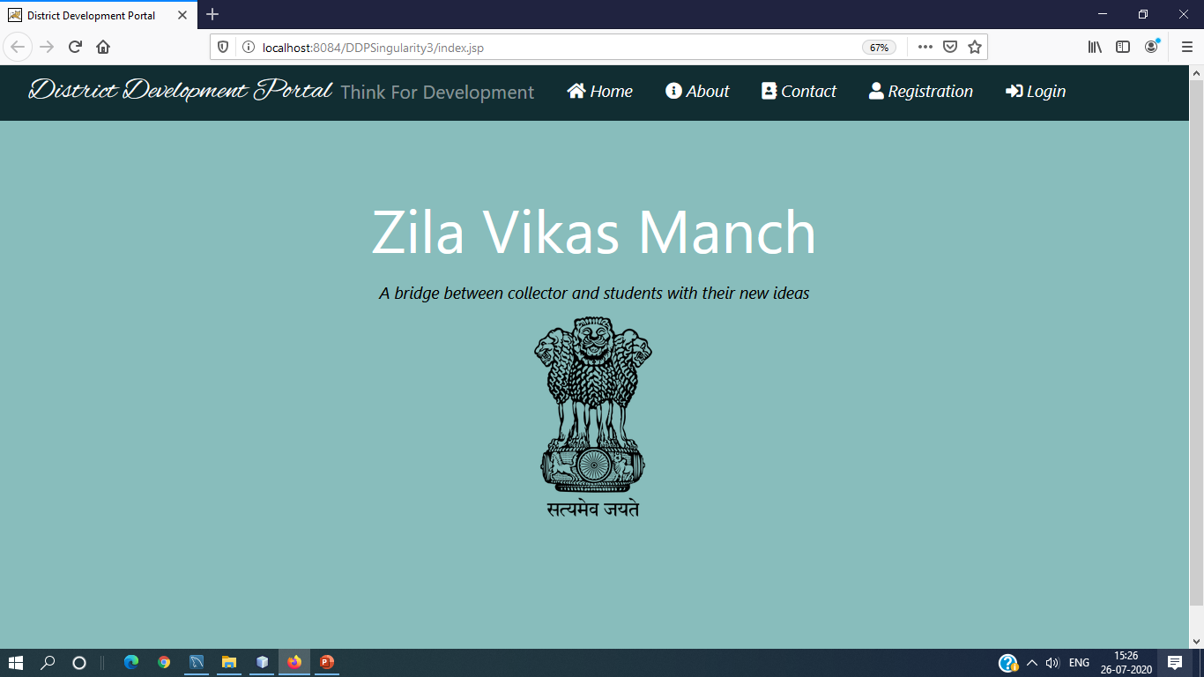

Slide 3
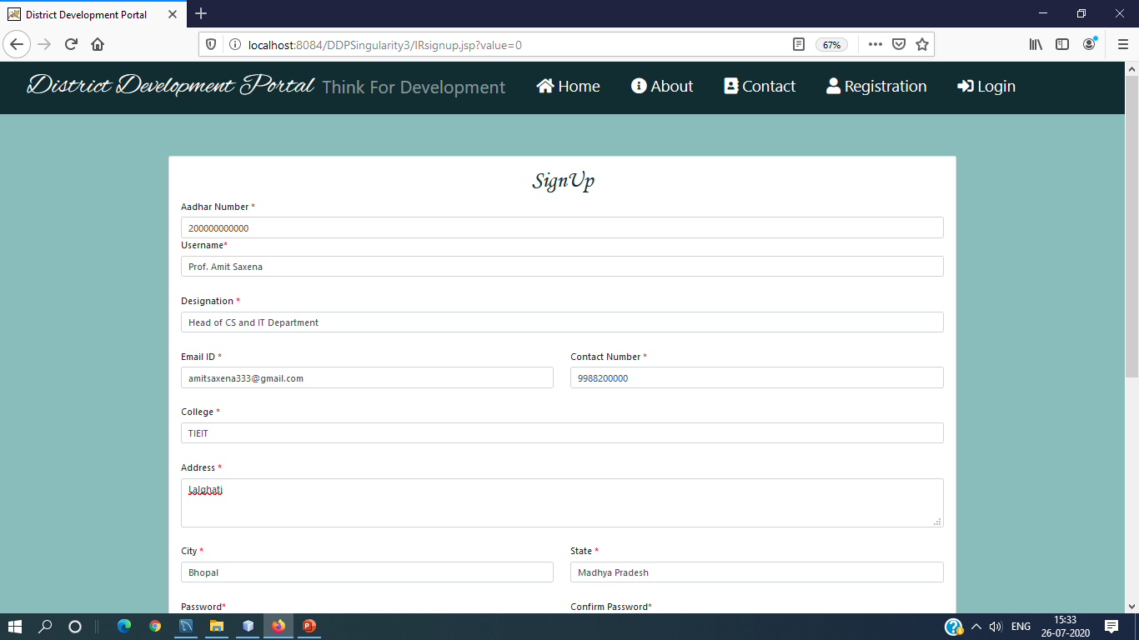

Slide 4
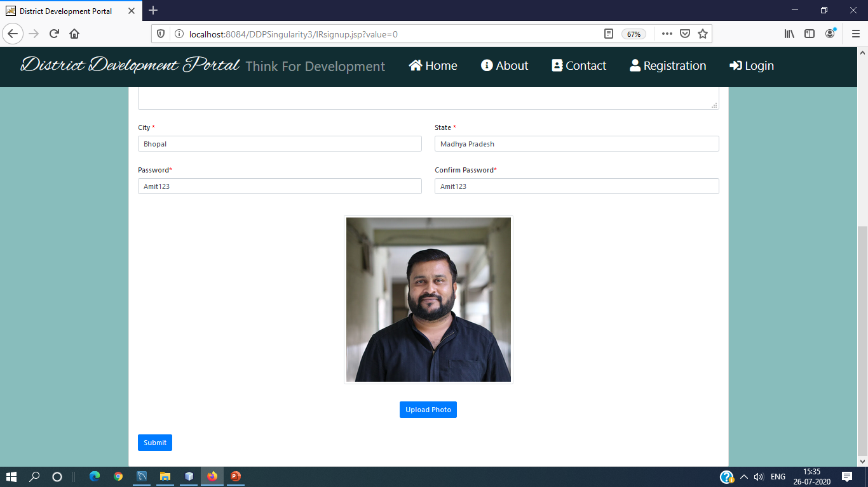

Slide 5
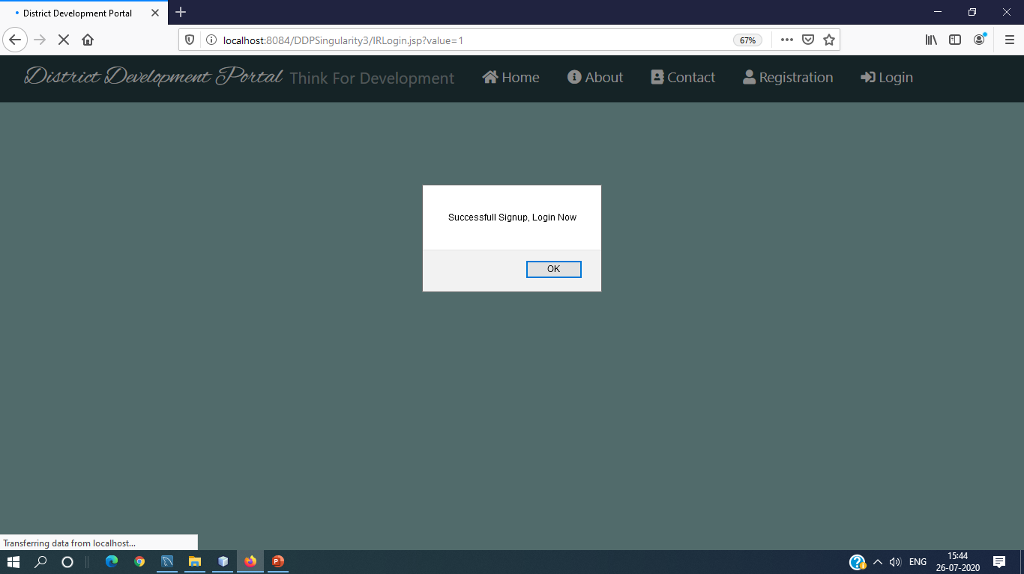

Slide 6
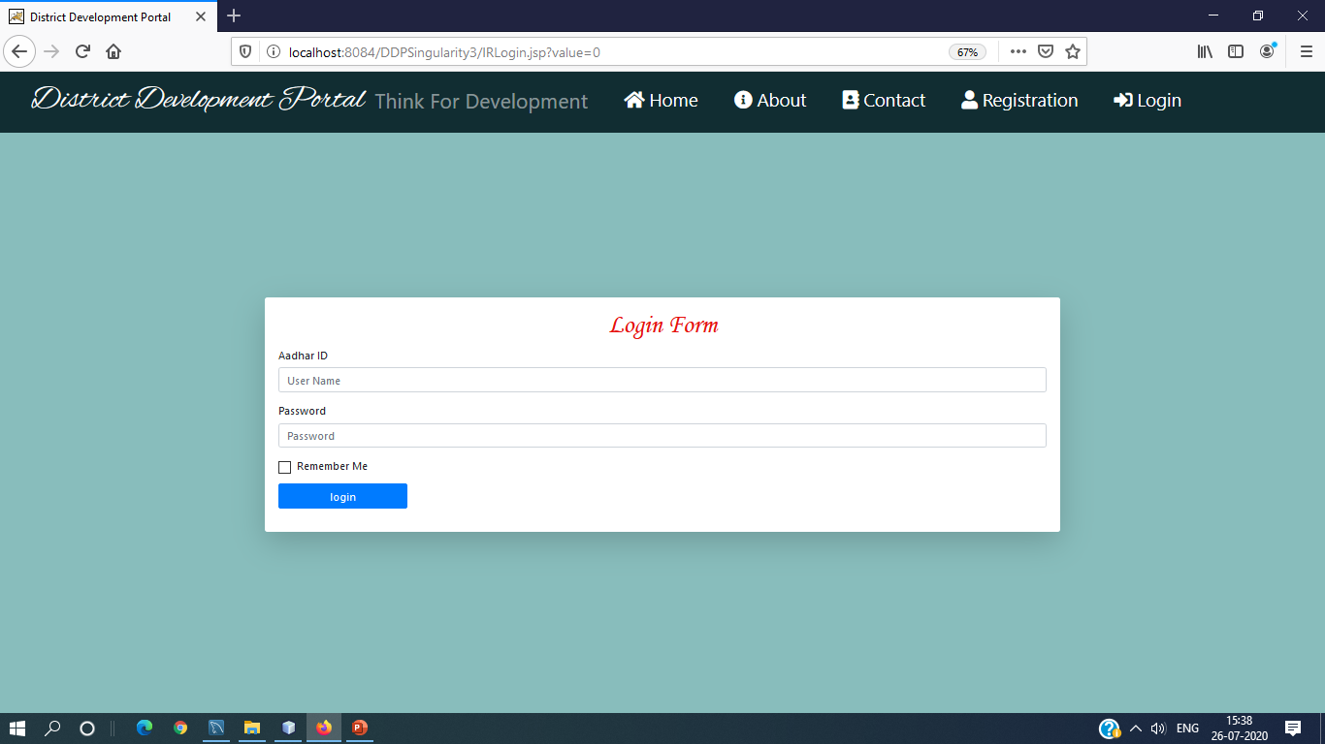

Slide 7


Slide 8
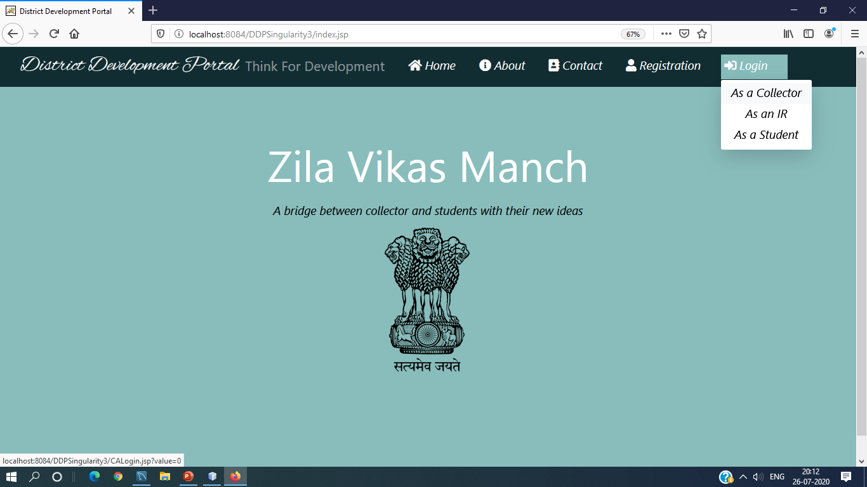

Slide 9
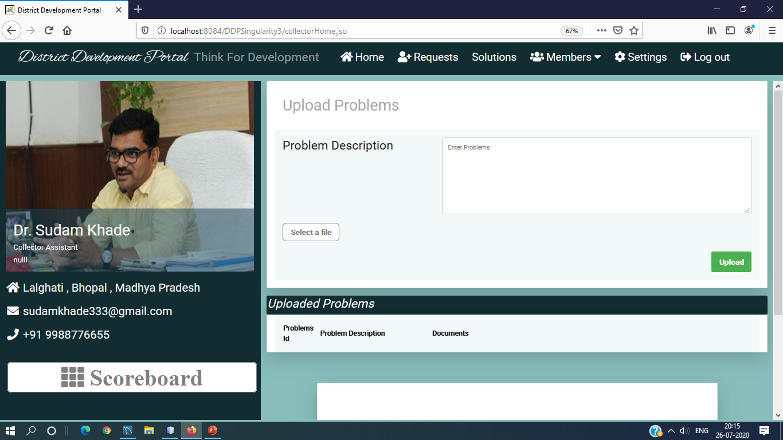

Slide 10
In newIRRequest.jsp page of CA
Select *from IRTable where status=null
Assign status = accept or reject

Slide 11
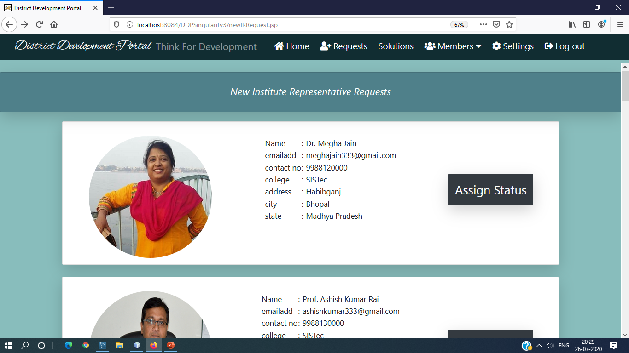

Slide 12
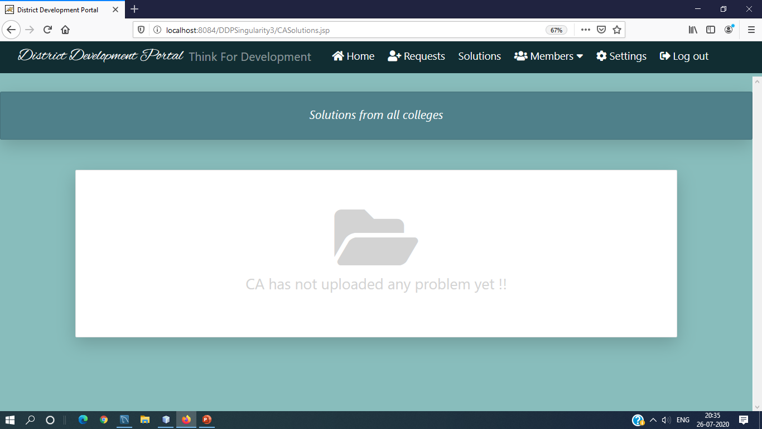

Slide 13


Slide 14


Slide 15
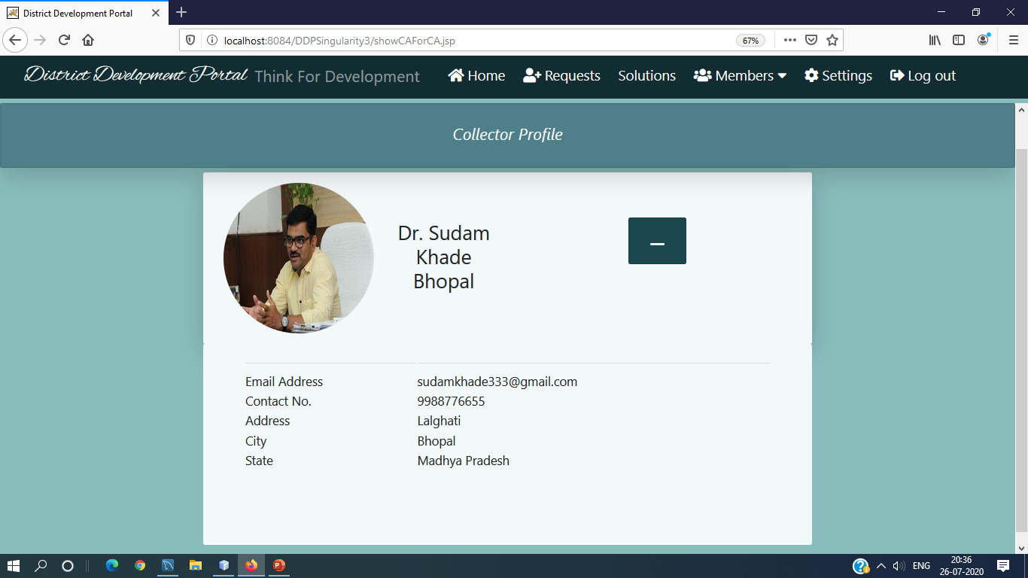

Slide 16
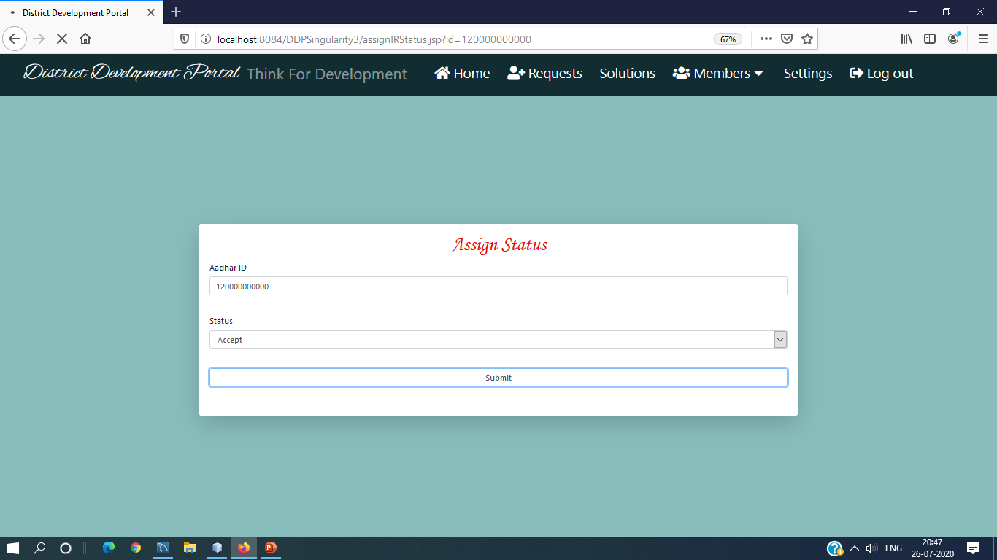

Slide 17
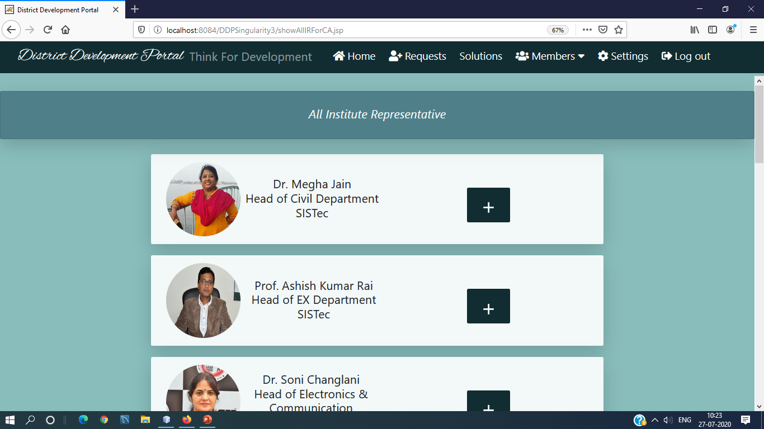

Slide 18
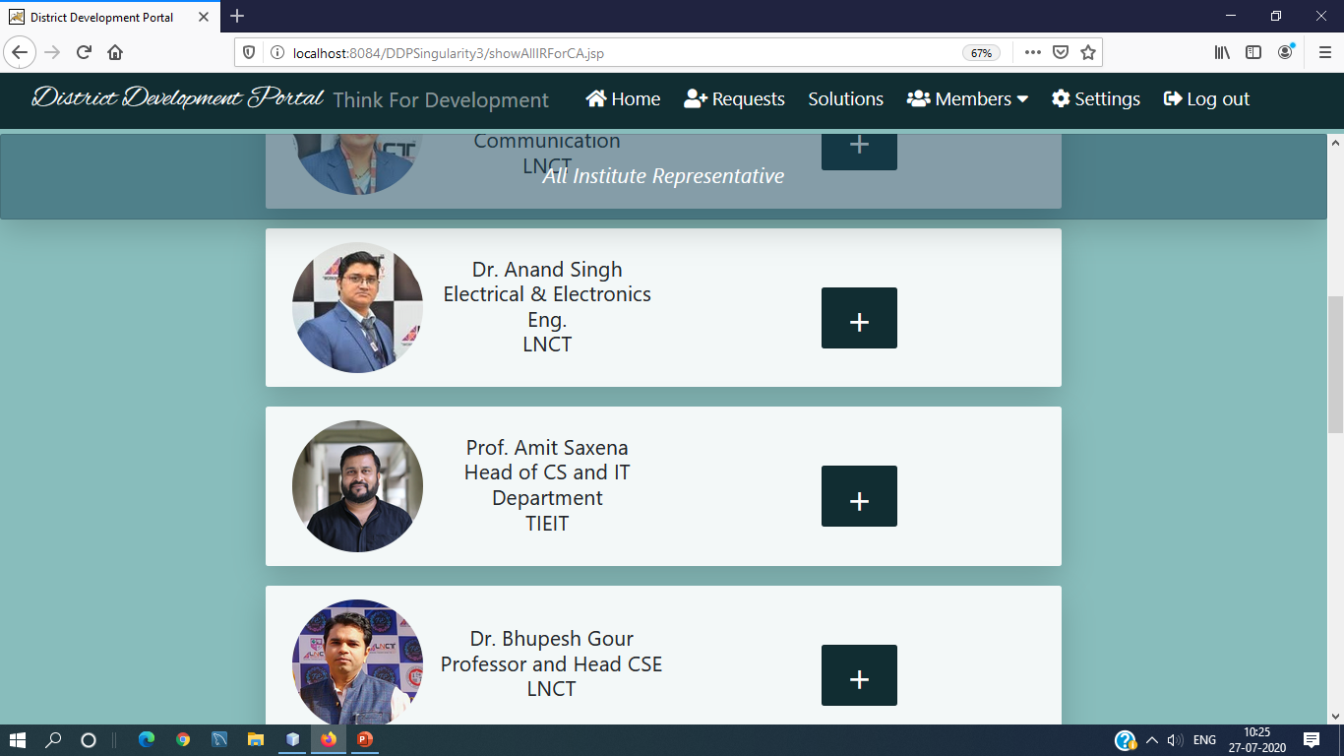

Slide 19
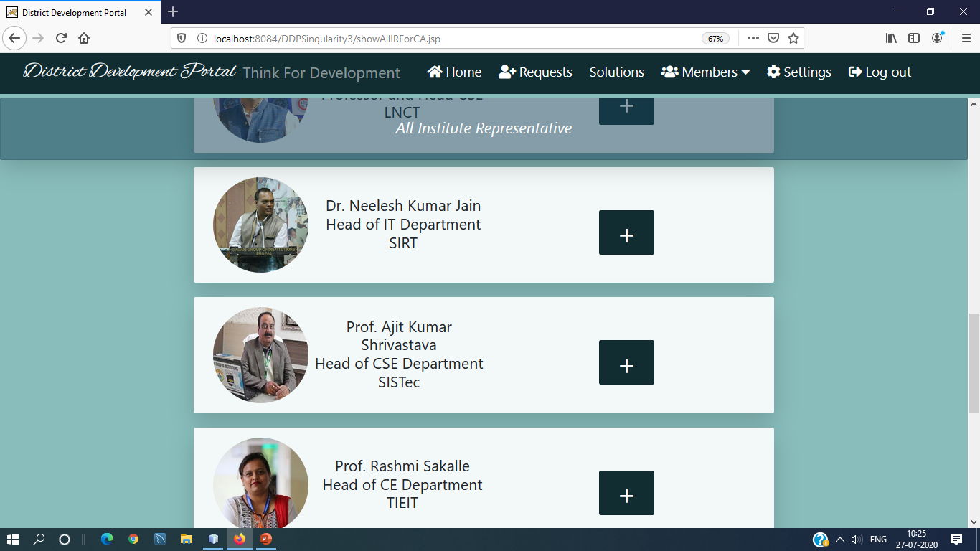

Slide 20
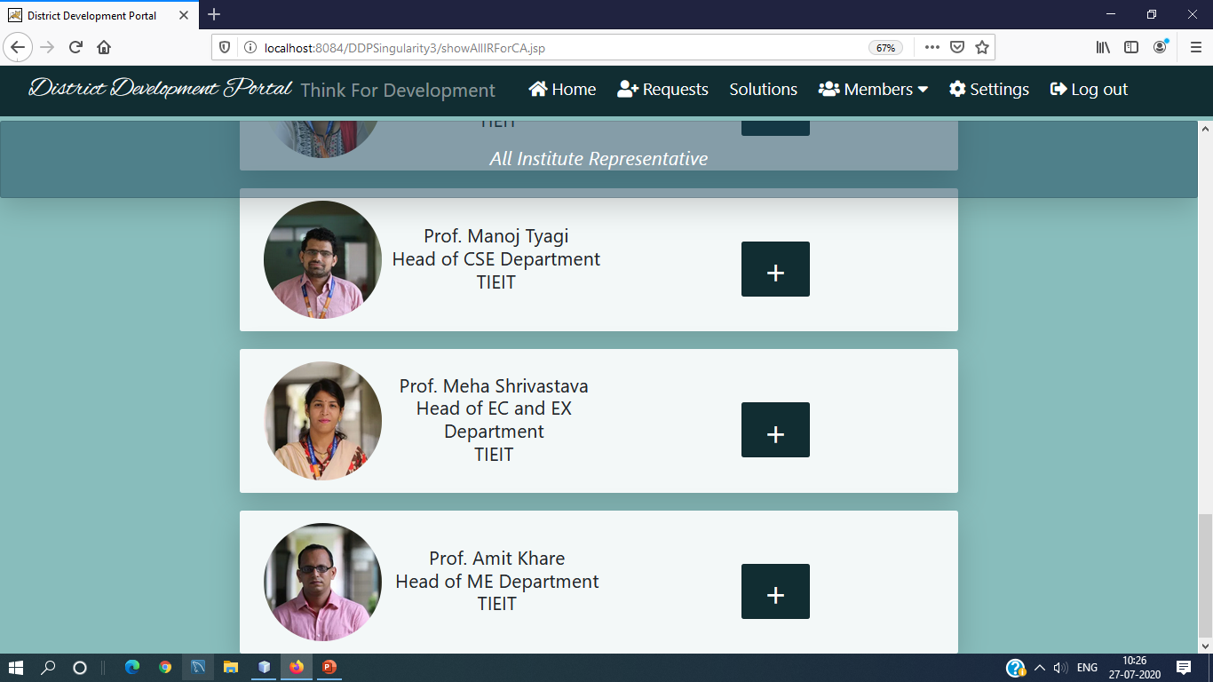

Slide 21
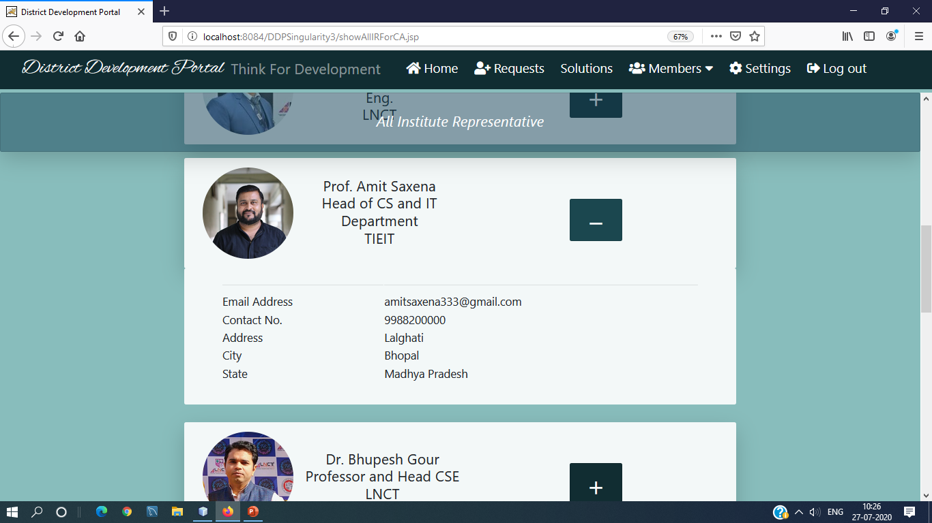

Slide 22
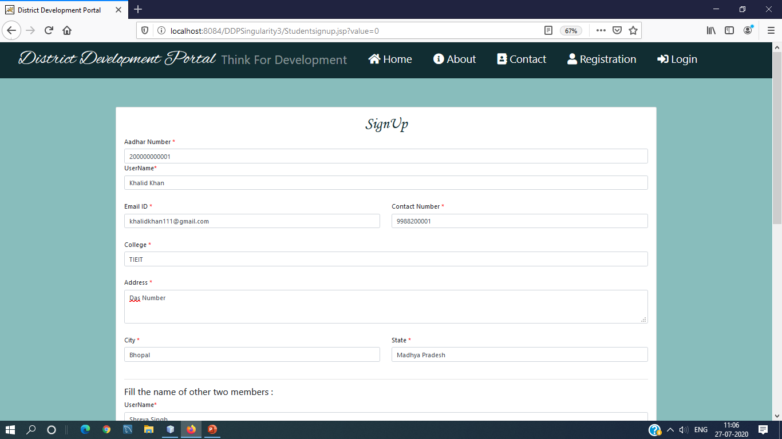

Slide 23
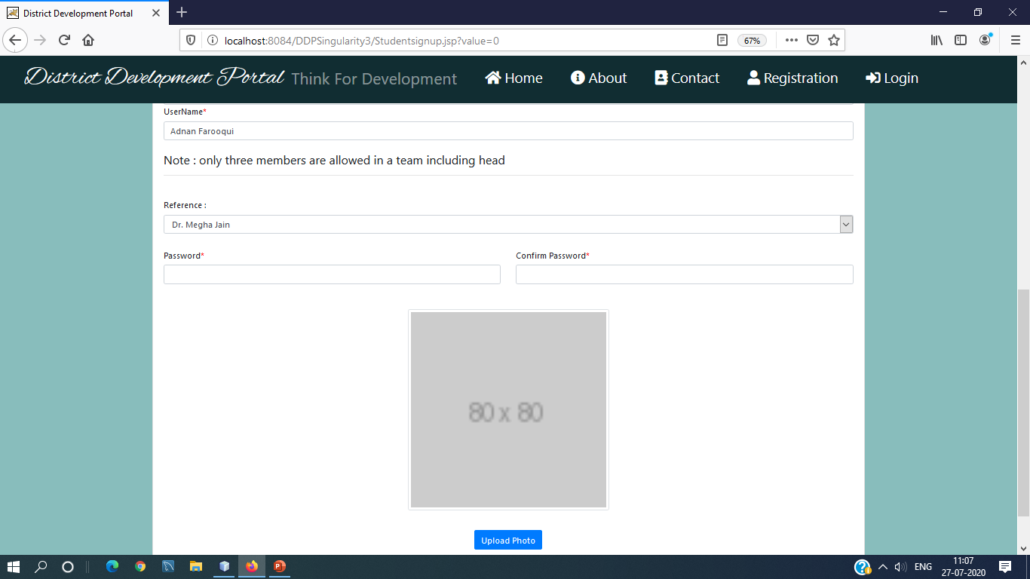

Slide 24
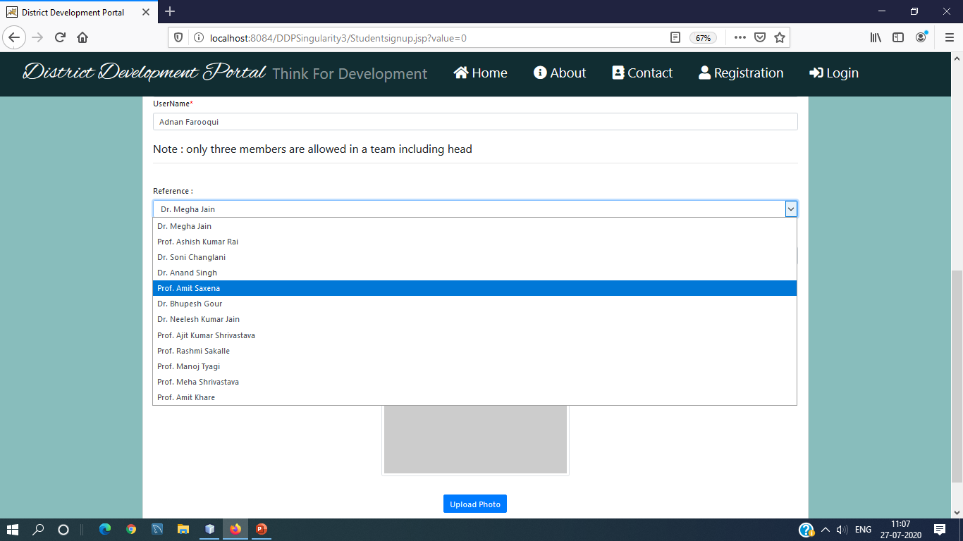

Slide 25
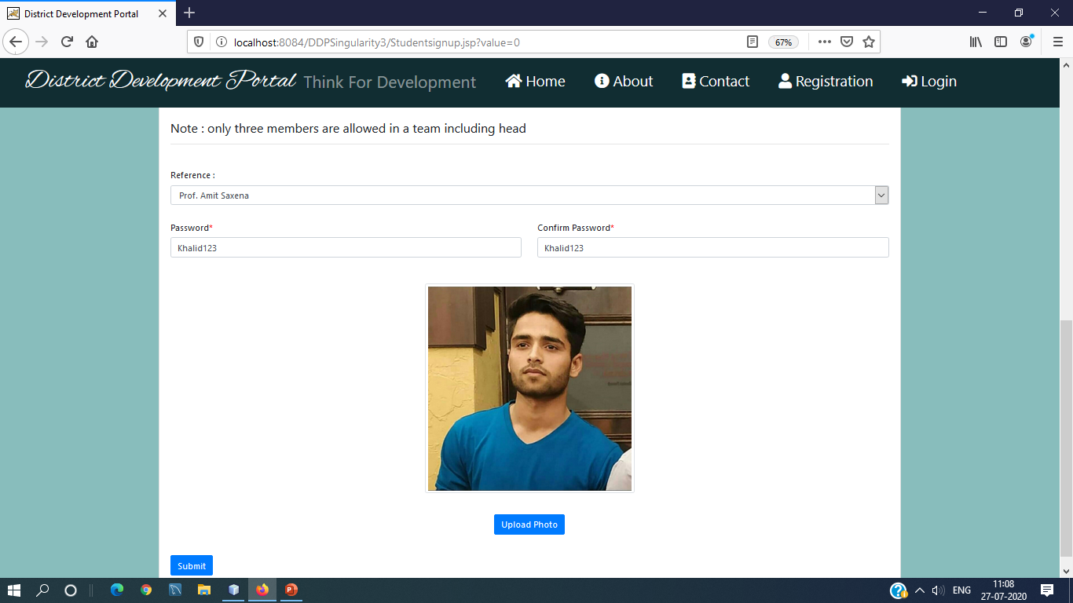

Slide 26
In newStudentRequest.jsp page of IR
Select *from StudentTable where status=null
Assign status = accept or reject

Slide 27
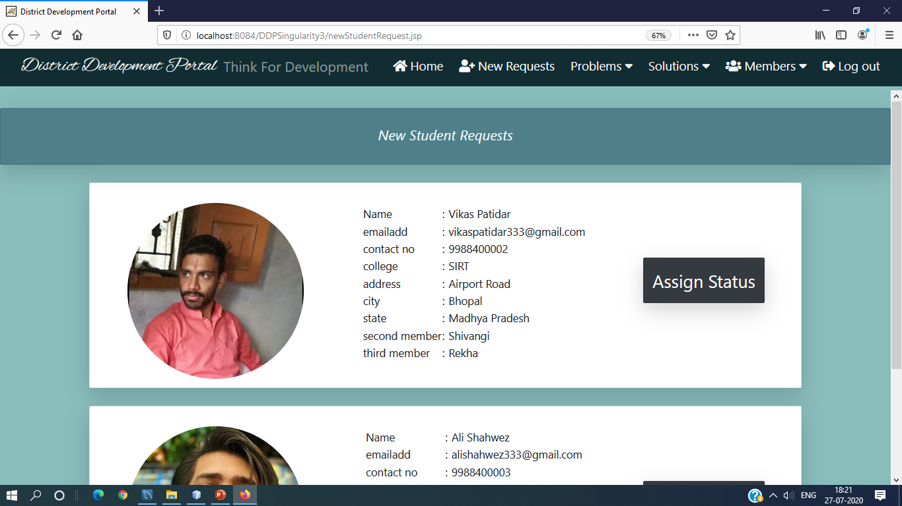

Slide 28
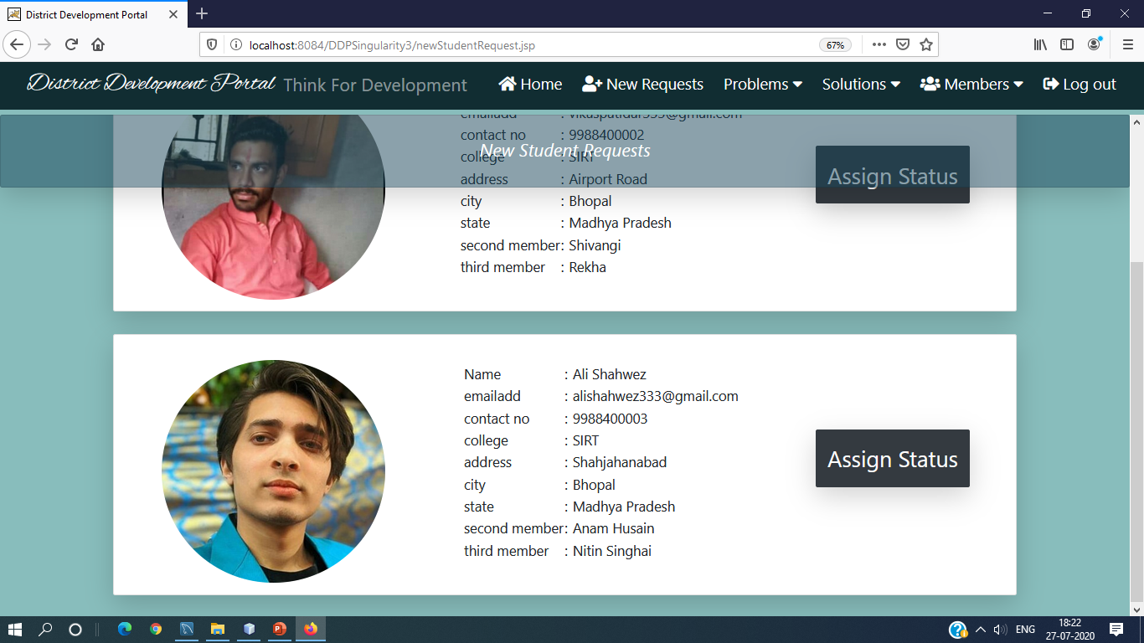

Slide 29
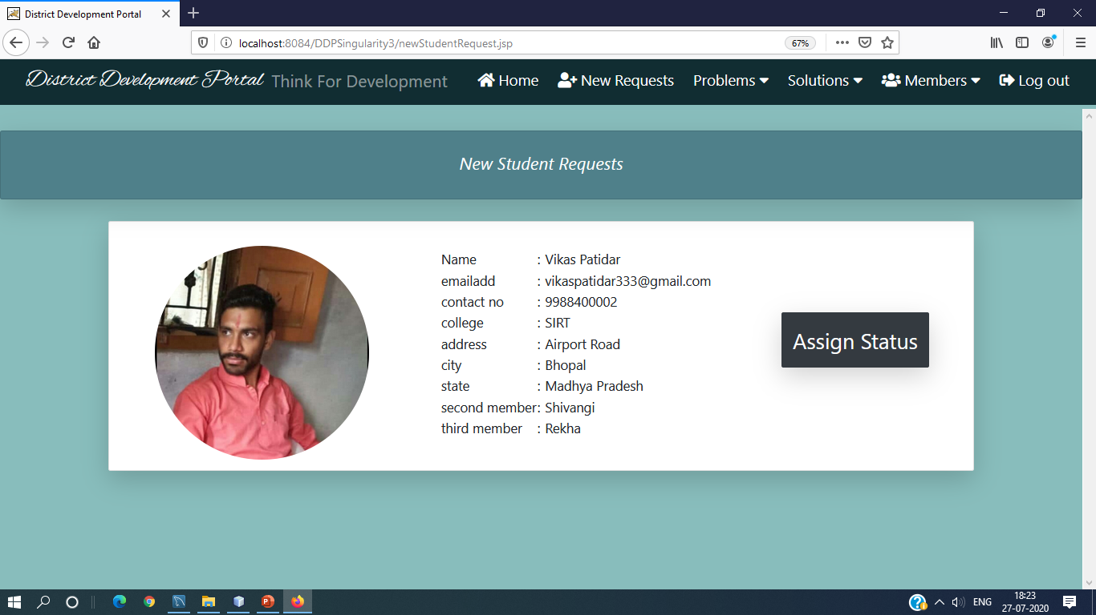

Slide 30
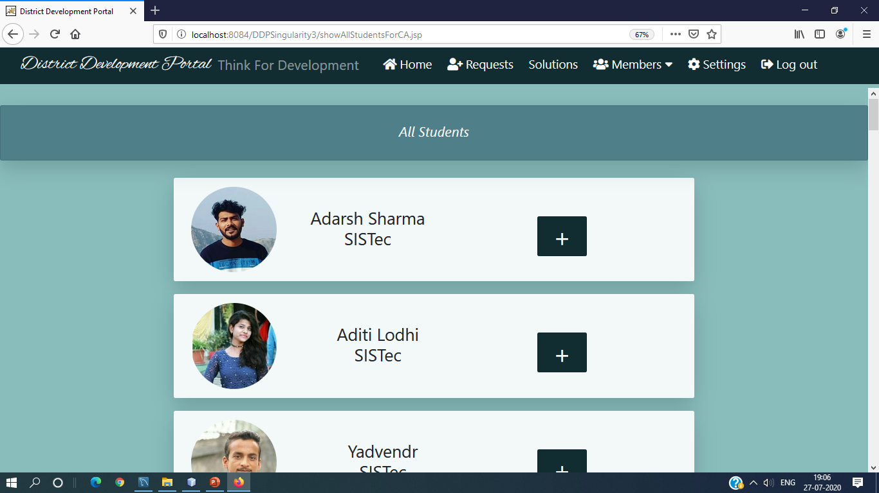

Slide 31
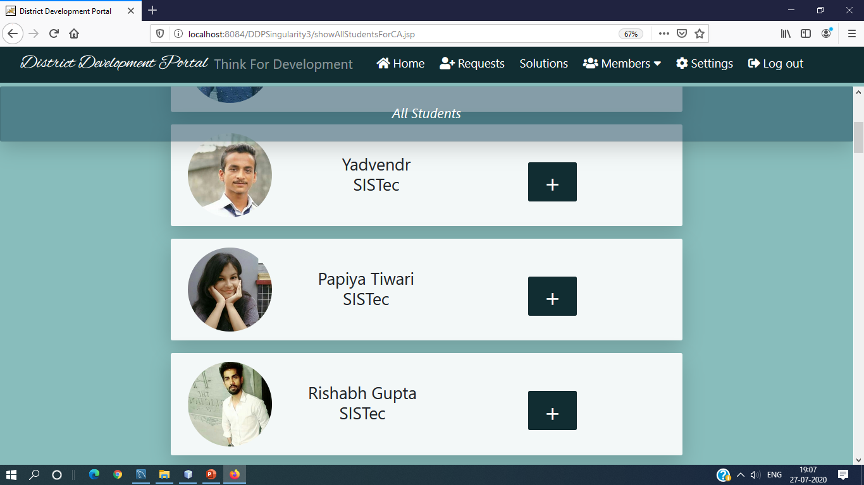

Slide 32
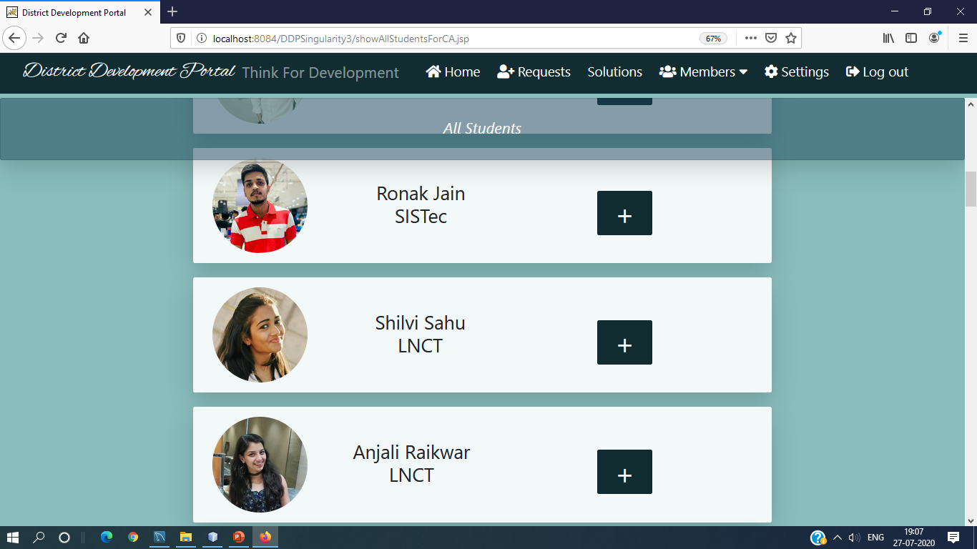

Slide 33
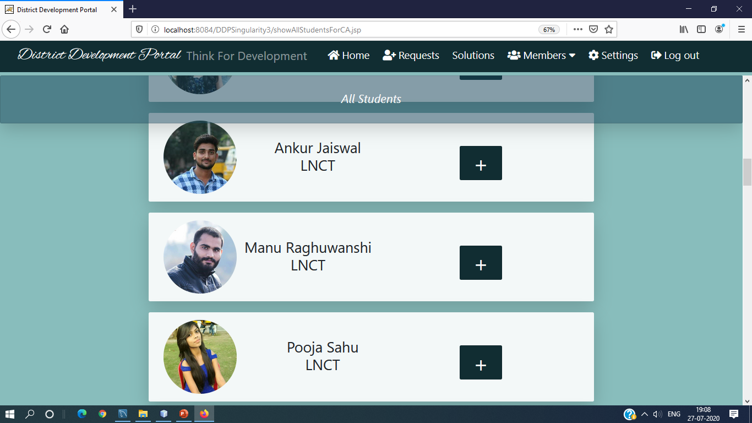

Slide 34
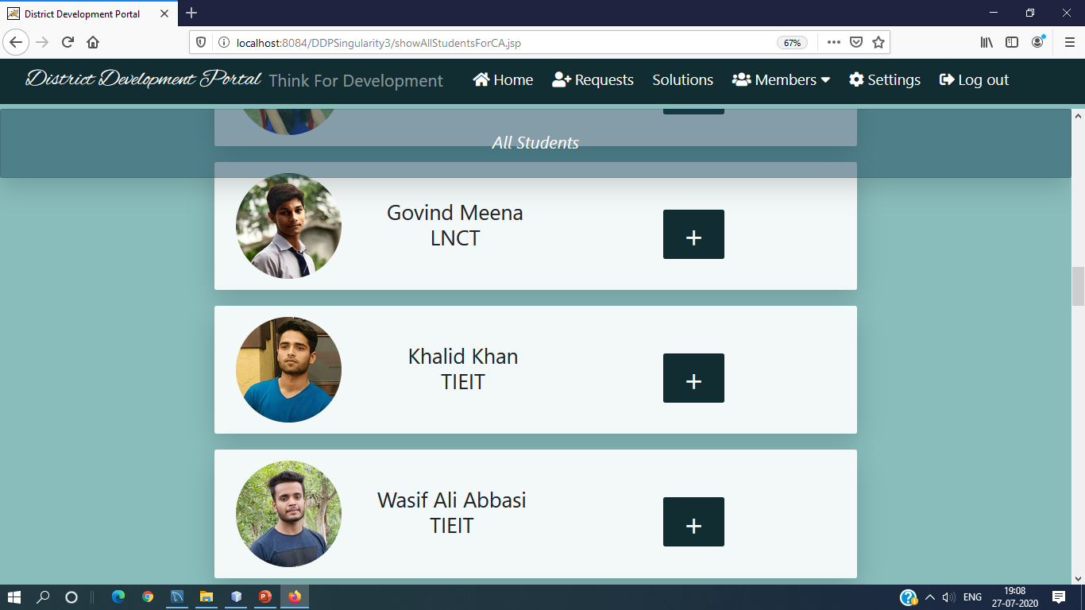

Slide 35
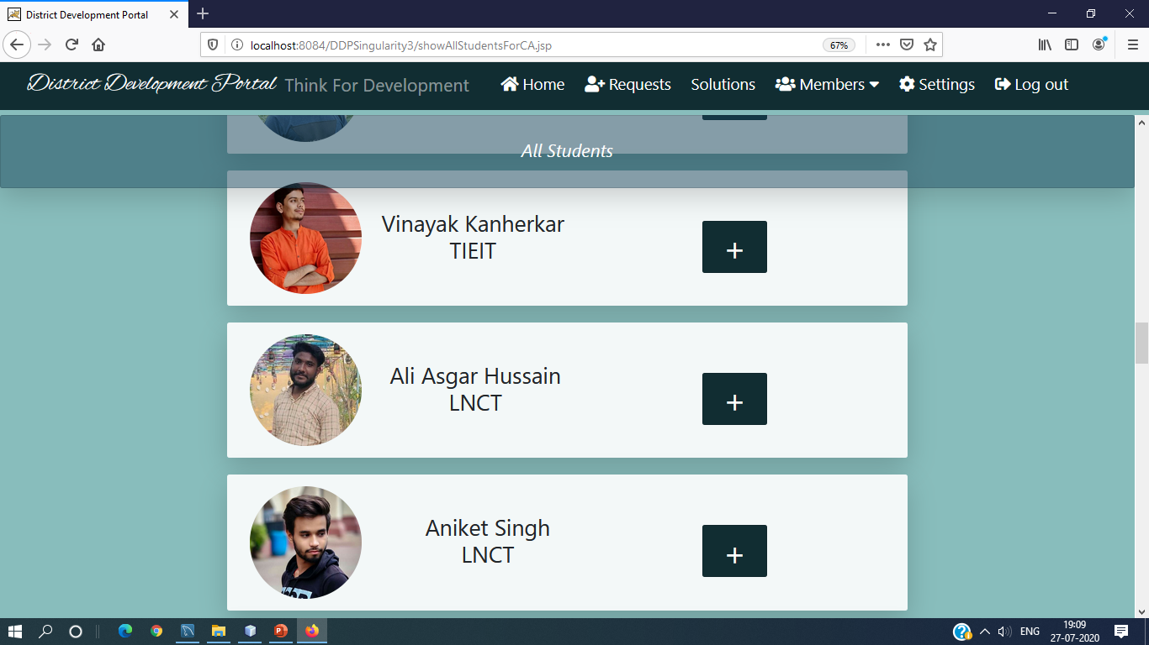

Slide 36
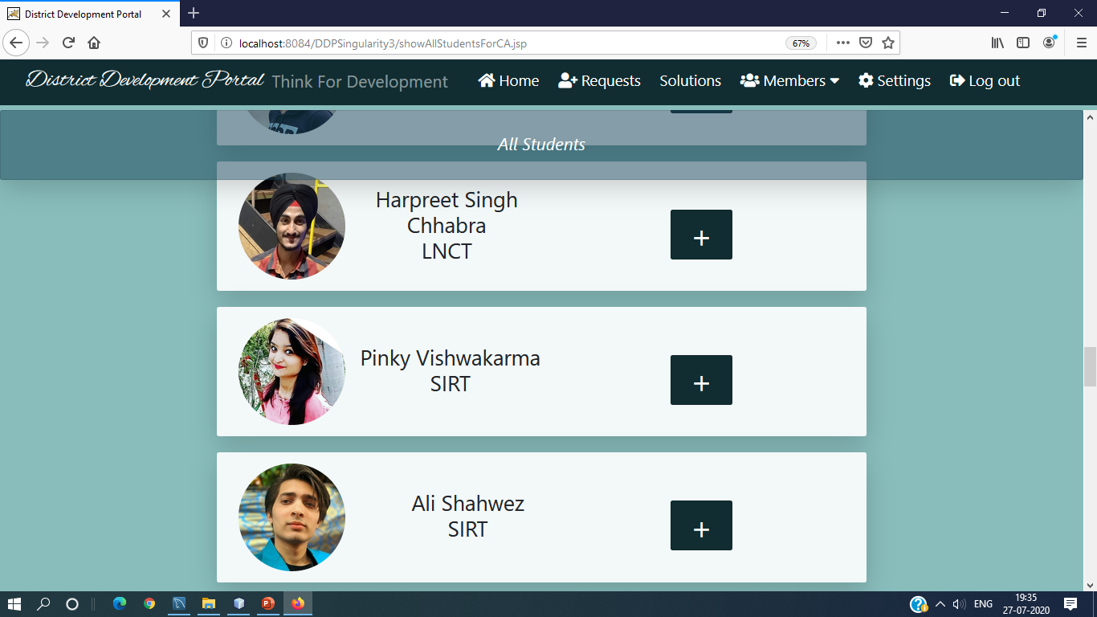

Slide 37
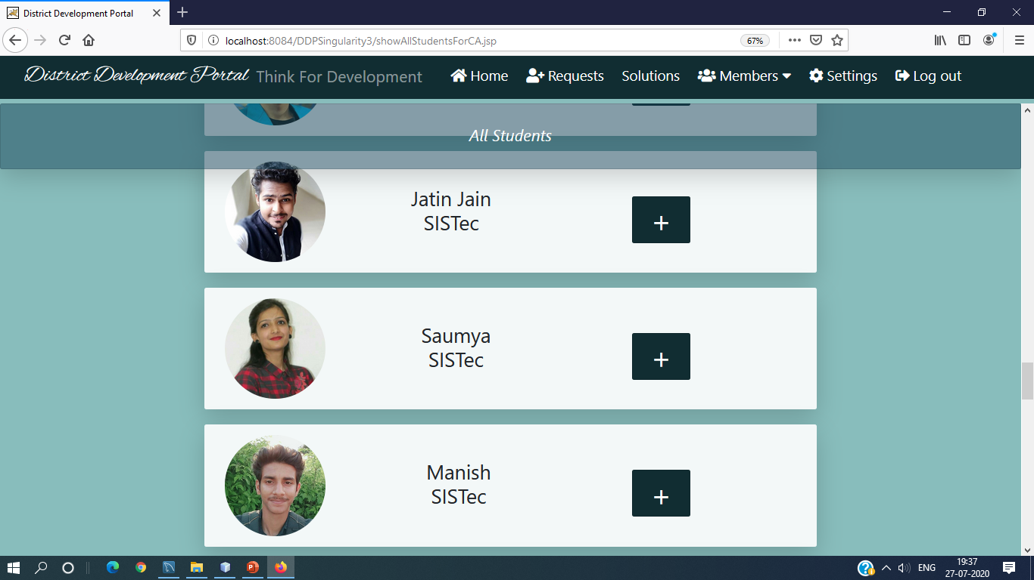

Slide 38
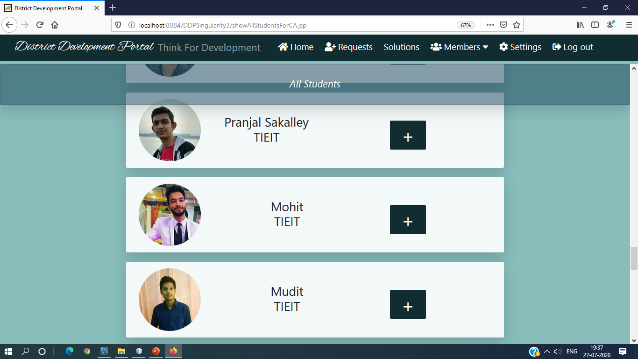

Slide 39
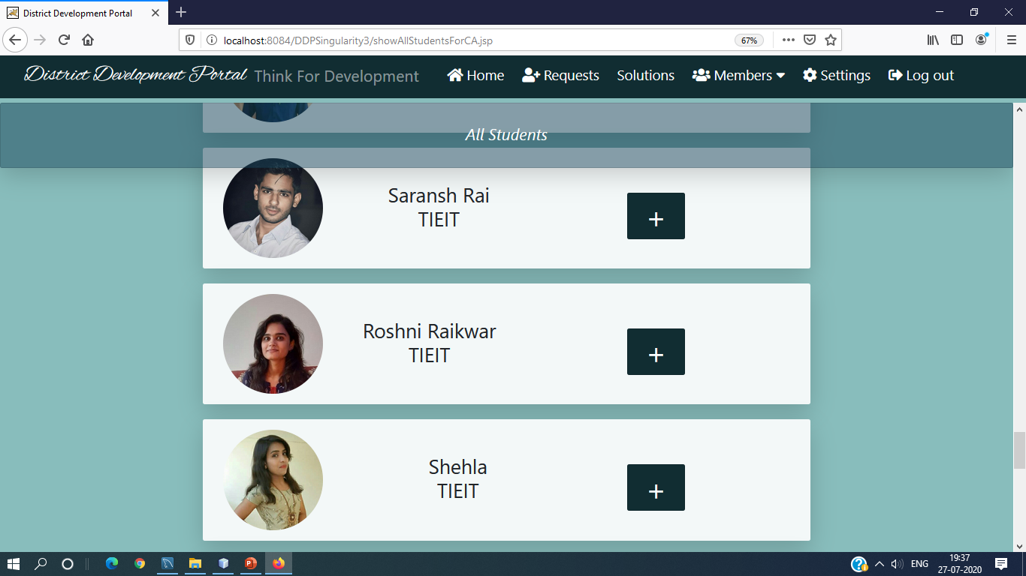

Slide 40
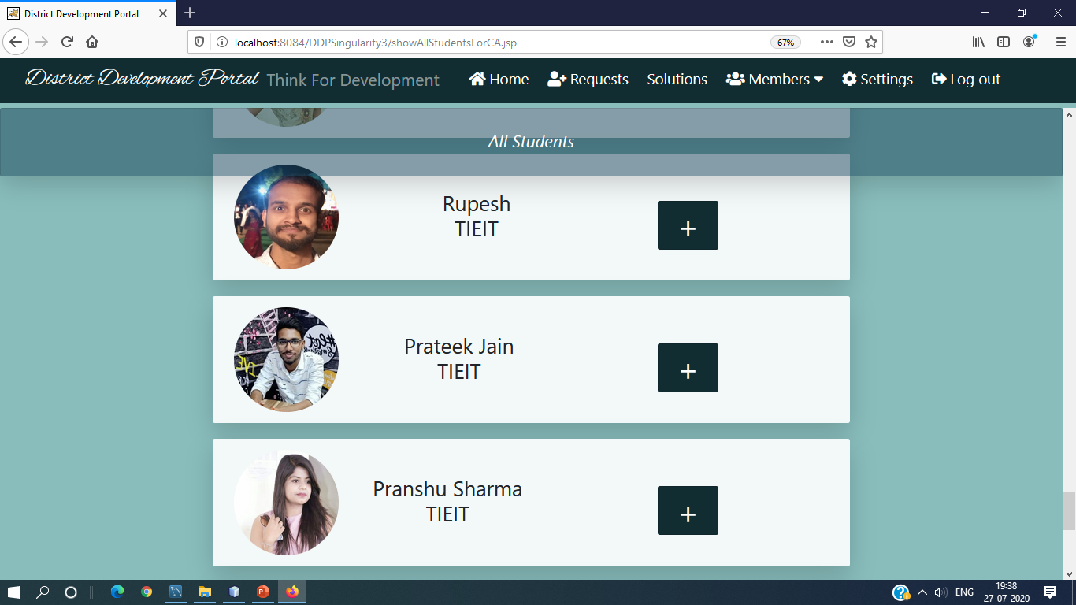

Slide 41
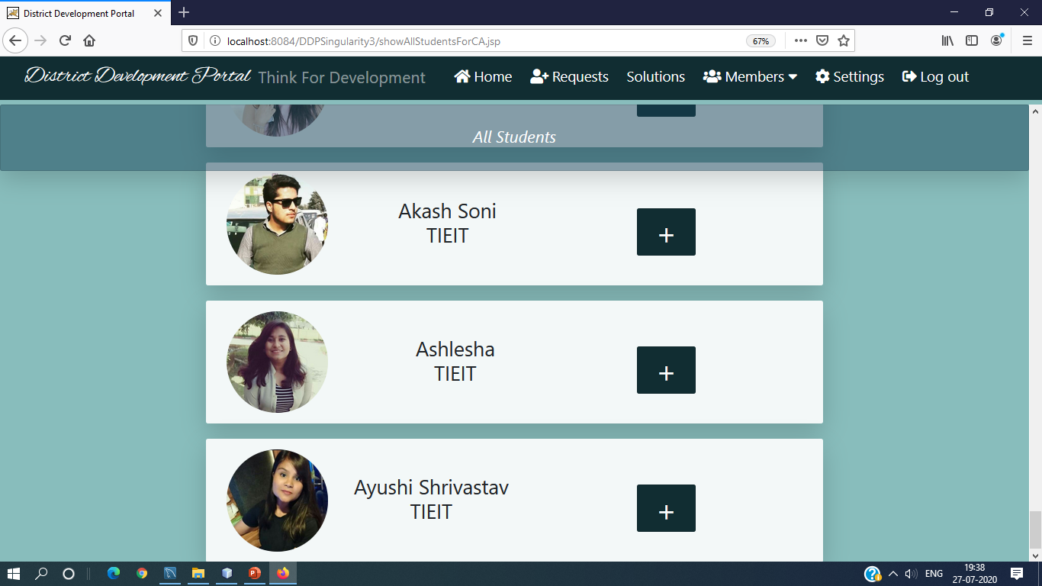

Slide 42
Collector can see his own profile
All IR
All Students
Institute Representative can also see collector profile
All IR
All students
Student can also see collector profile
All IR
All Students

Slide 43
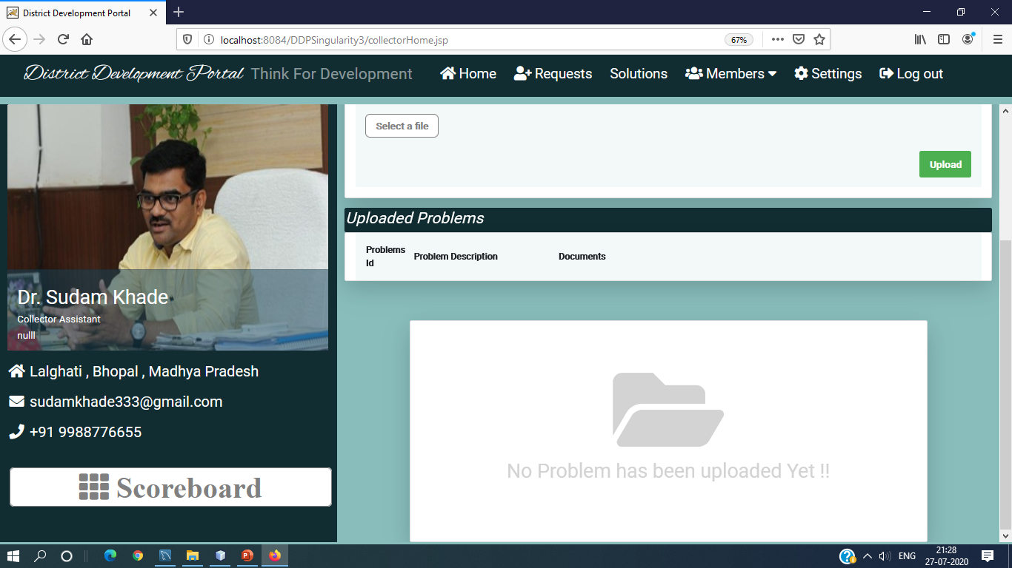

Slide 44
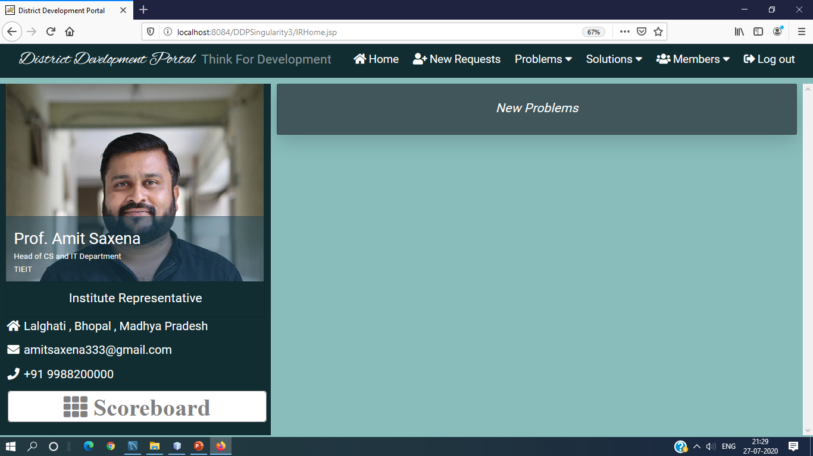

Slide 45
When CA Upload problem:
Insert into CAProblems with Status=“UnSolved”
No need to do anything for StatusAaadharid,it will automatically store null value

Slide 46
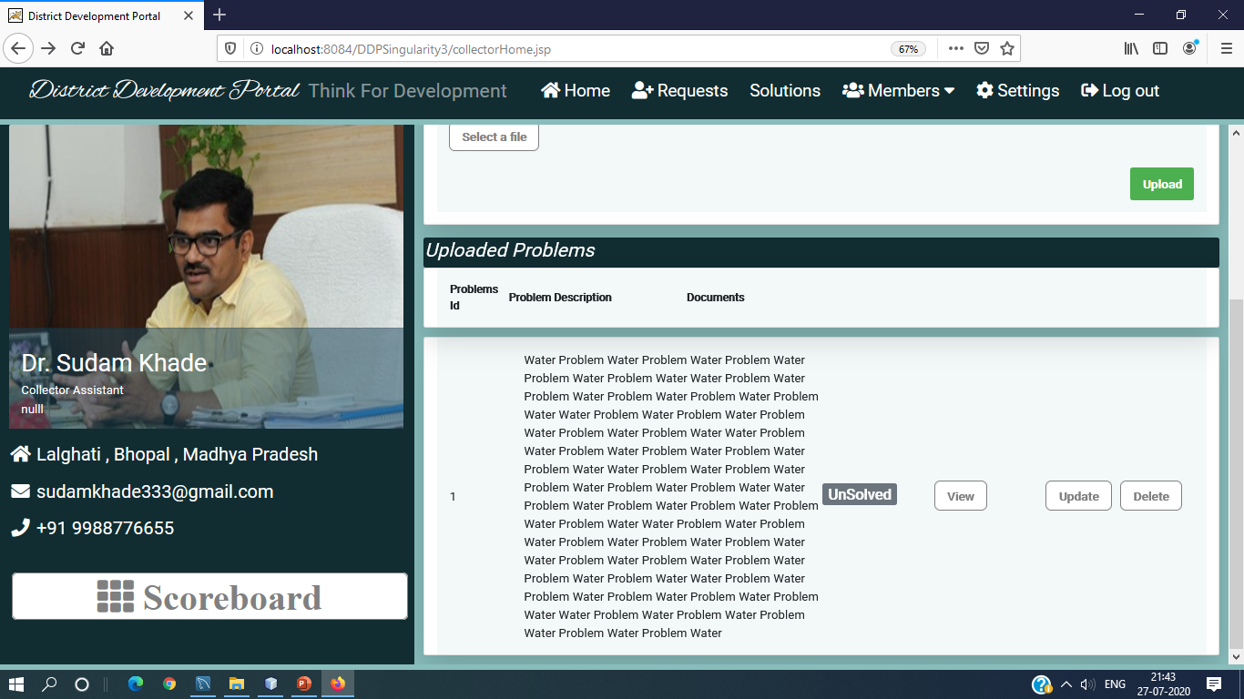

Slide 47
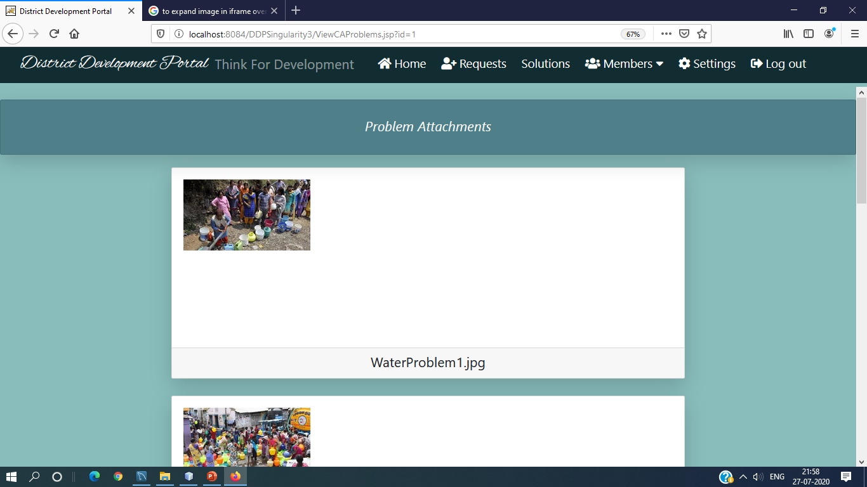

Slide 48
In IRHome.jsp
Select *from CAProblems where status=“UnSolved”
In CAAllProblems.jsp
Select *from CAProblem;

Slide 49
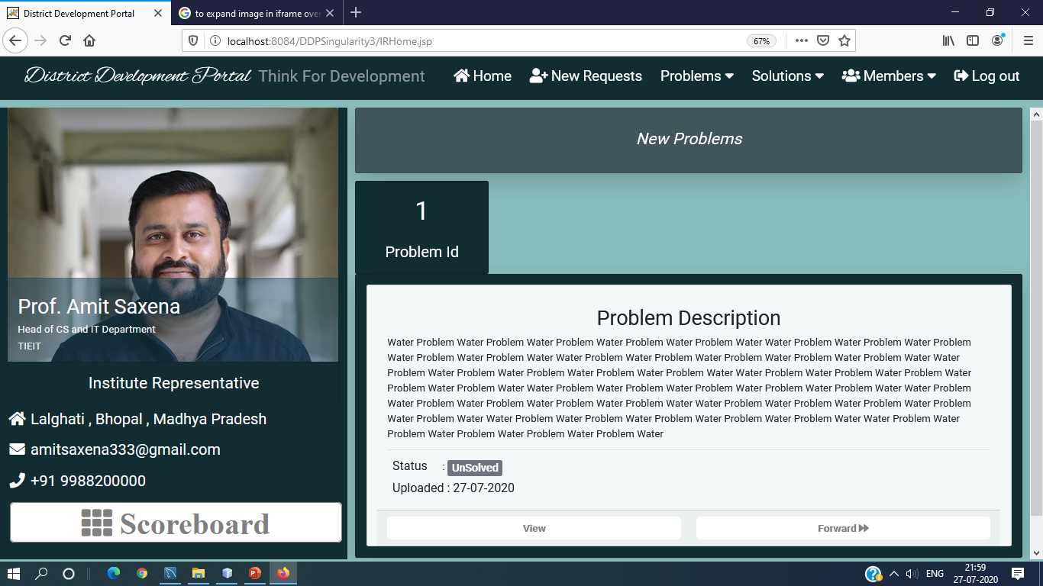

Slide 50


Slide 51
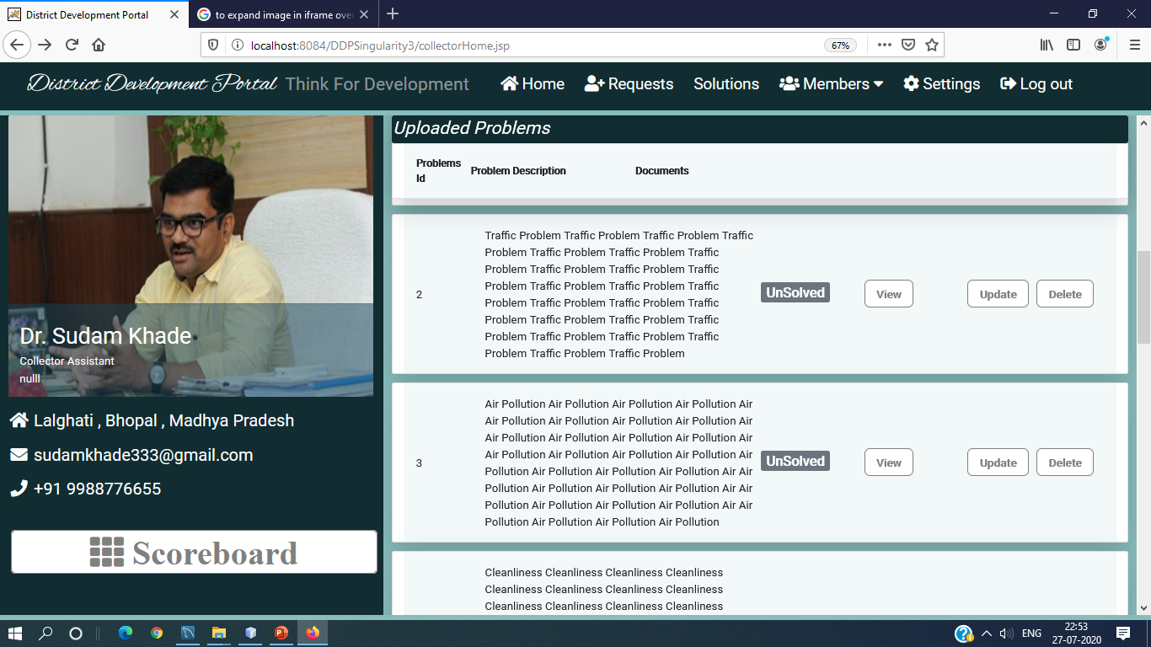

Slide 52
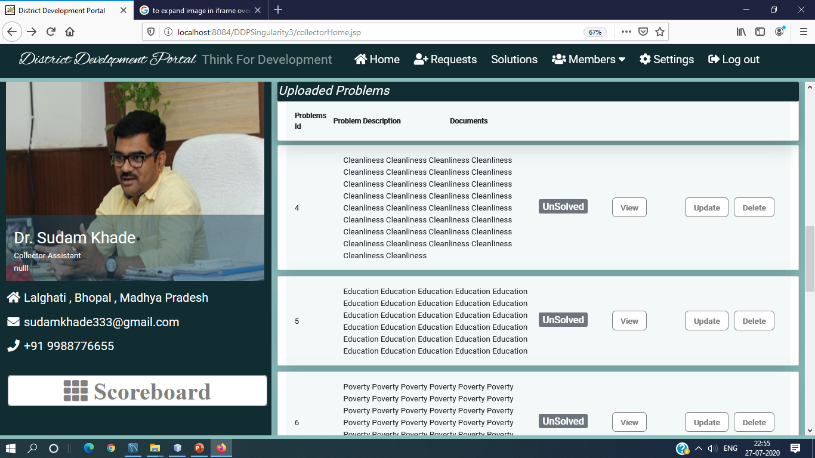

Slide 53
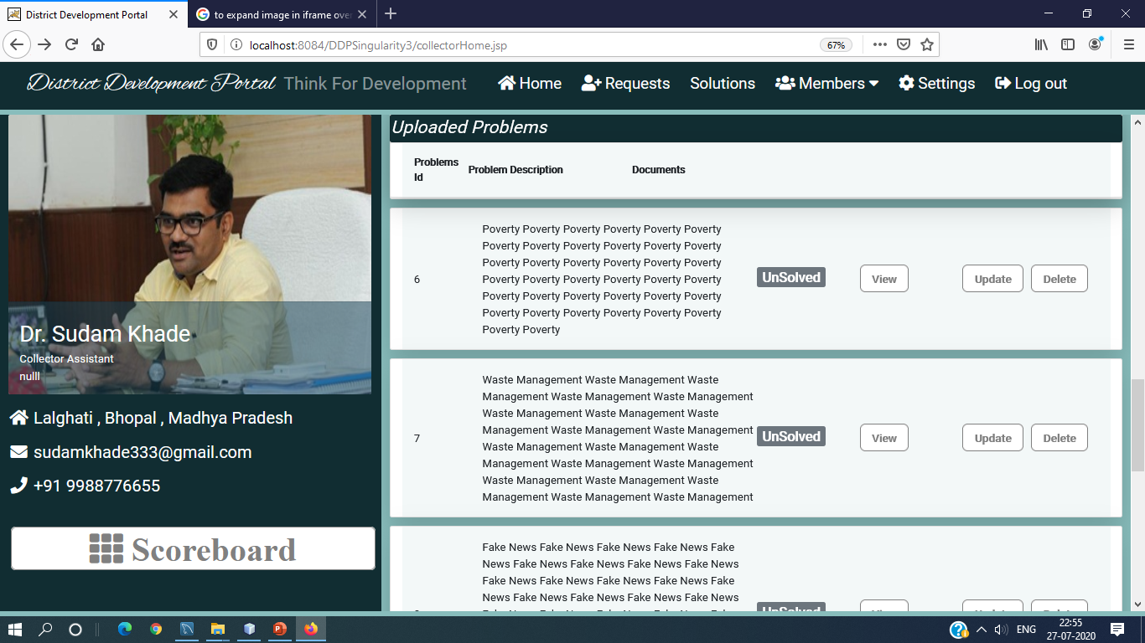

Slide 54
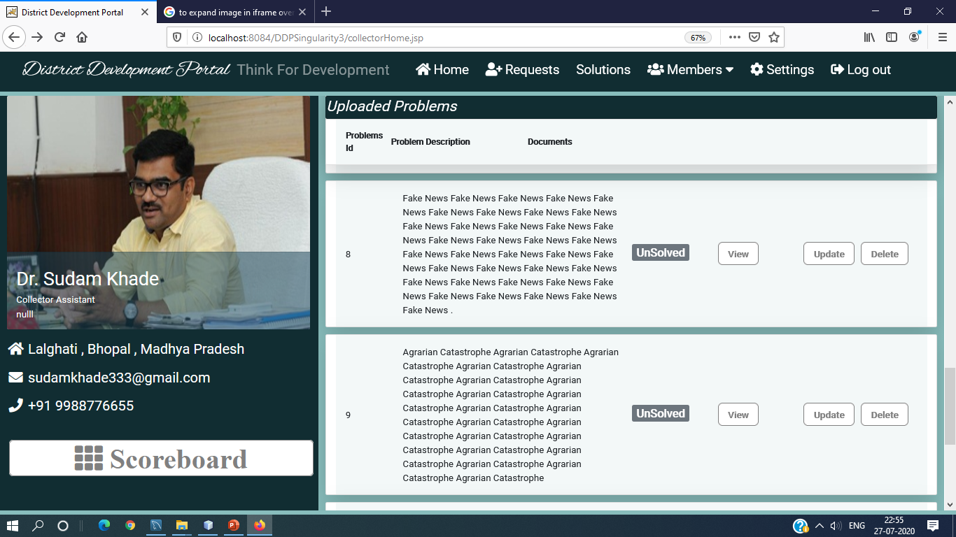

Slide 55
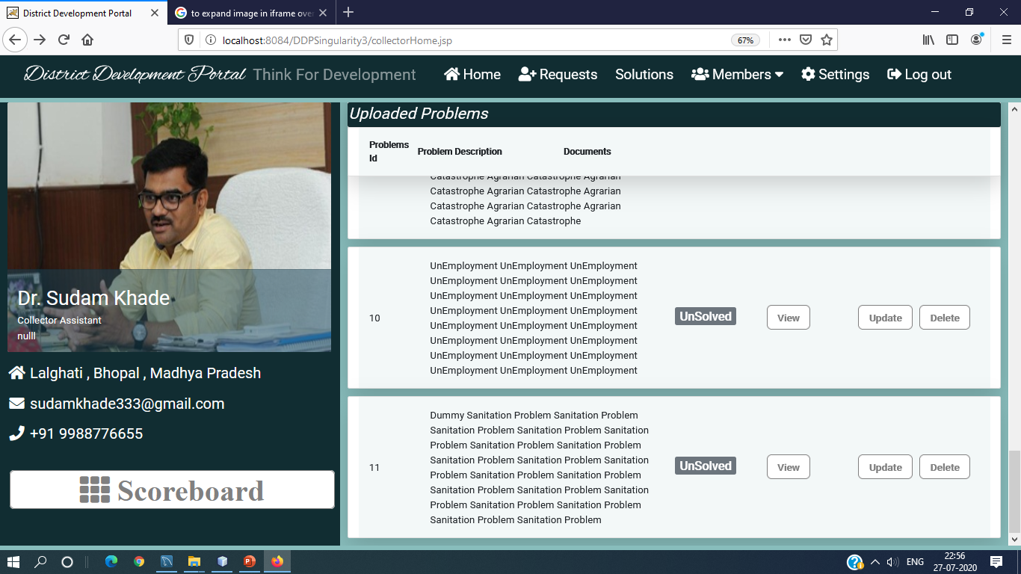

Slide 56
When IR forward problem
Insert into IRProblem with Status1=‘’UnSolved’’ , Status2=“UnSelected”
Update CAProblems StatusAadharid=“forwarded”

Slide 57
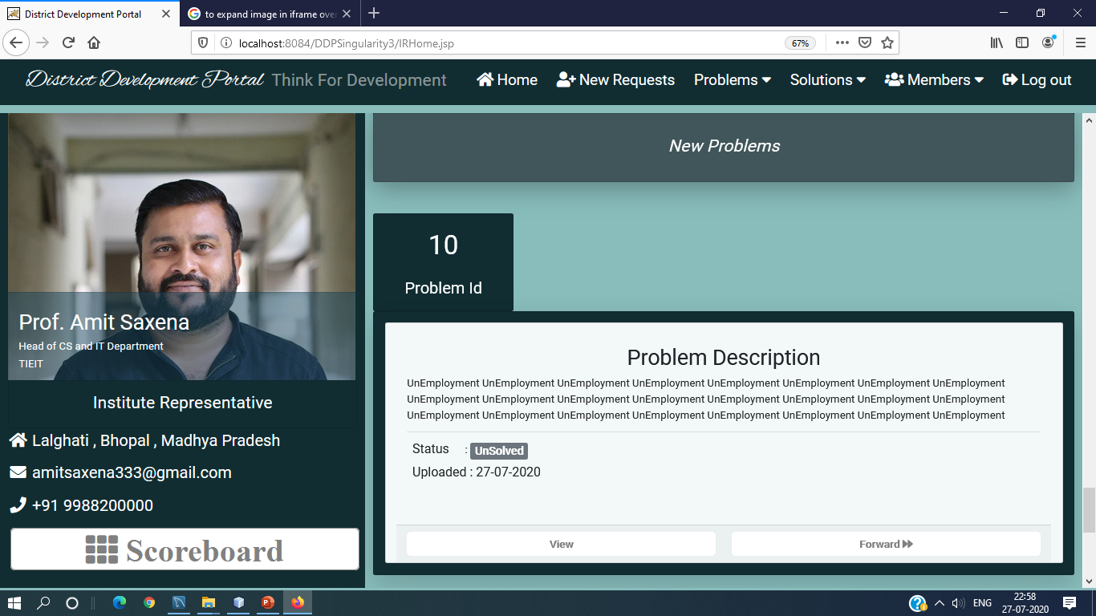

Slide 58
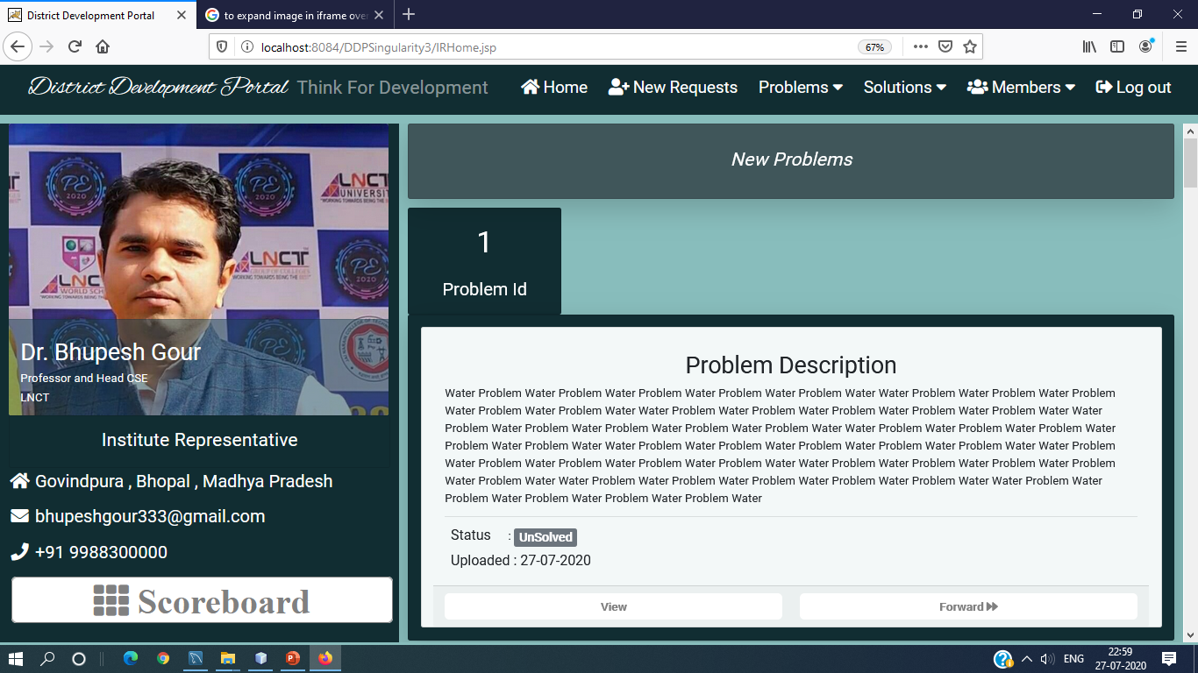

Slide 59
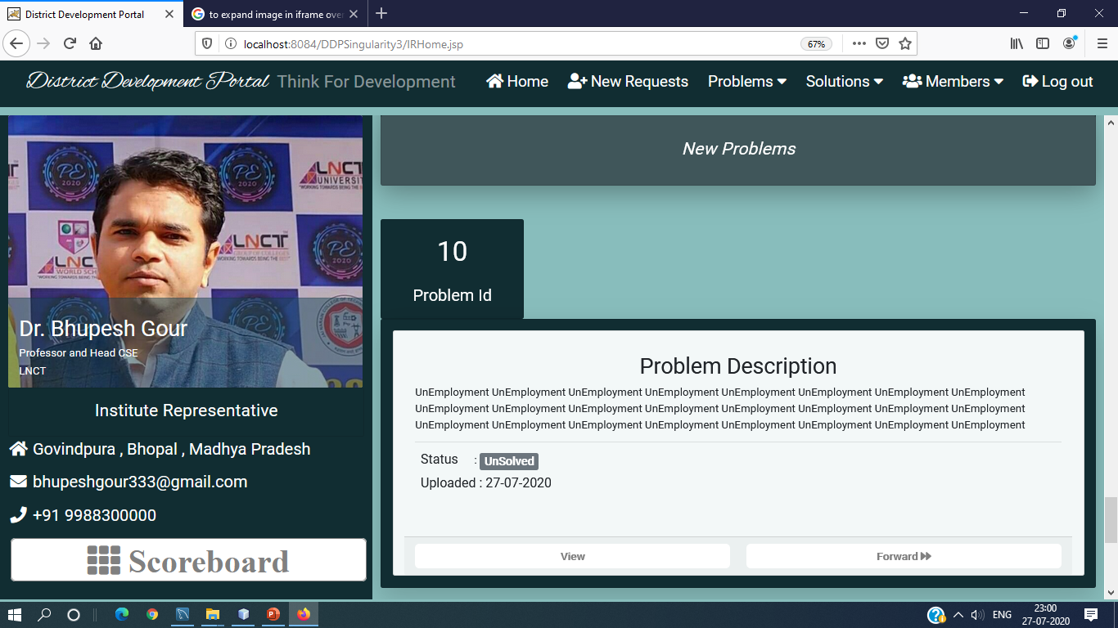

Slide 60
In studentHome.jsp
Select *from AadharidIRProblems where Status1=“UnSolved”
Status2 wil show as Selected , UnSelected or Under Consideraion

Slide 61
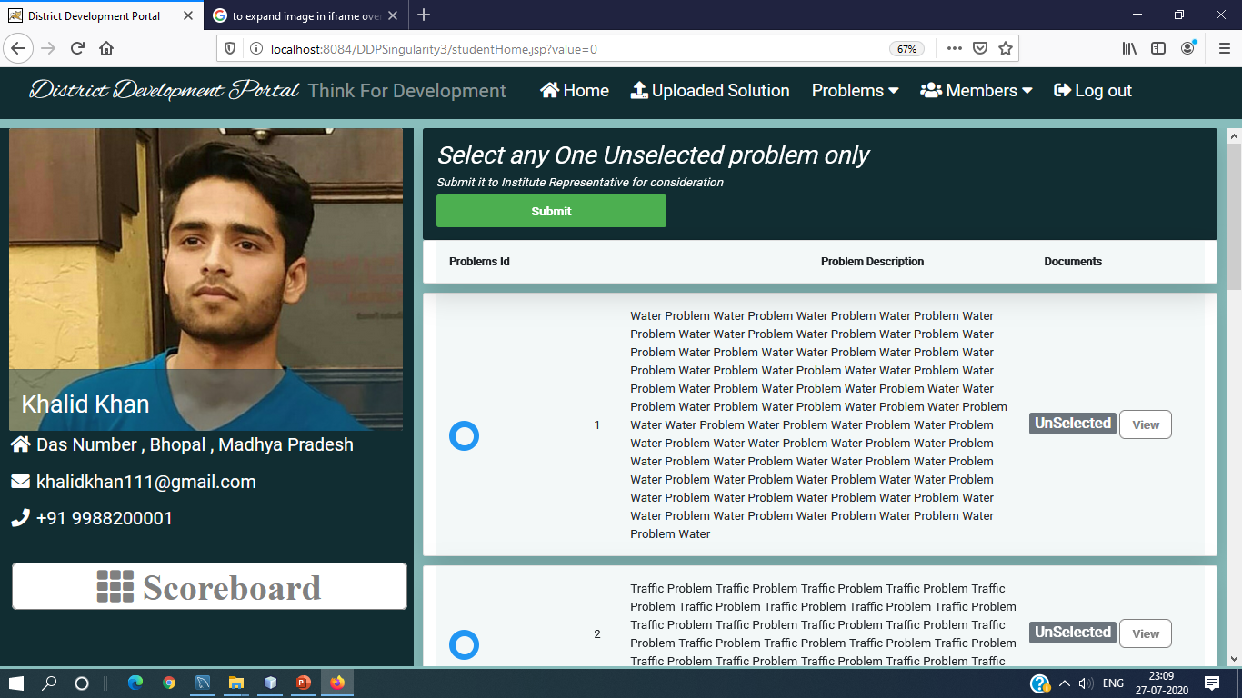

Slide 62


Slide 63
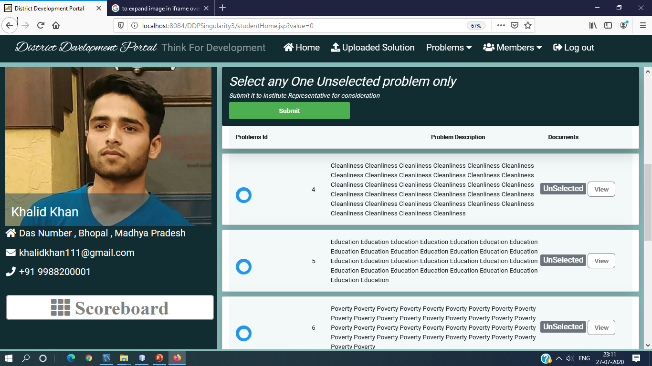

Slide 64


Slide 65


Slide 66
In ProblemsSelectedByStudentFT.jsp
Select *from AadharidStudentProblems;

Slide 67


Slide 68


Slide 69
12
In studentHome.jsp
When student select any one problem and submit then:
Selected problem is inserted into 200000000000StudentProblems with aadharid=aadharid of student and Status2= Not Accepted Yet
Update :
Status2 of selected problem in 200000000000IRProblems is updated by “Under Consideration”

Slide 70


Slide 71


Slide 72


Slide 73

None of the students of same HOD can select the problem which is Under Consideration.

Slide 74


Slide 75


Slide 76


Slide 77


Slide 78


Slide 79


Slide 80


Slide 81
13
In selectedProblemStatus.jsp
Select *from StudentProblems
Status2 of StudentProblems will be equal to “Not Accepted Yet”
Check Suggestions button will not be there.

Slide 82


Slide 83
14
In ProblemsSelectedByStudentFT.jsp
Select *from AadharidStudentProblems;
Since, Status2=“Not Accepted Yet”
When IR Reconsider the problem
=> Update StudentProblems with Status2=“Rejected”

Slide 85


Slide 86


Slide 87


Slide 88
15
In SelectedProblemStatus.jsp
Select *from Aadharid StudentProblems
It will also check for suggestions(Status3) in IRProblems
If there is no StudentAadharid in Status3 of IRProblems and Status2 of StudentProblems as “Not Accepted Yet”.Then check for suggestion button will be disabled .

Slide 89

At Student Side , Student will check the status of the problem

Slide 90


Slide 91
16
In suggestIRProblems.jsp
Select *from IRProblems;
IR will select 3 UnSelected problems and will suggest to student.
Status2 and Status3 of all the 3 suggested problems of IRProblems Table is updated by “Under Consideration” and Student’s Aadharid respectively.

Slide 92


Slide 93


Slide 94


Slide 95


Slide 96


Slide 97
In ProblemsSelectedByStudentFT.jsp
=> select *from StudentProblems;
Since , Status2=“Rejected”
Both Accept and Reconsider buttons will be disabled

Slide 98


Slide 99
17
In SelectedProblemStatus.jsp
Select *from Aadharid StudentProblems
It will also check for suggestions(Status3) in IRProblems
If there is StudentAadharid in Status3 of IRProblems and Status2 of StudentProblems as “Rejected”.Then Check Suggestions button will be enabled .

Slide 100


Slide 101
In selectOneOutOfThree.jsp
=> Select *from IRProblems where Status3=StudentAadharid
Student will again select one problem and will click on Suggest button
Delete from StudentProblems where aadharid=Student’s Aadharid
update IRProblems set status2='UnSelected' where P_id=P_id of deleted problem
Insert selected problem into StudentProblems
Update IRProblems set Status2=“Under Consideration” where P_id=P_id of selected problem

Slide 102


Slide 103


Slide 104
In selectedProblemStatus.jsp
Select *from StudentProblems
Status2 of StudentProblems will be equal to “Not Accepted Yet”
Check Suggestions button will not be there.

Slide 105


Slide 106


Slide 107
In ProblemsSelectedByStudentFT.jsp
Select *from AadharidStudentProblems;
Since, Status2=“Not Accepted Yet”
Accept and Reconsider both the buttons will be enabled.
When IR Accept the problem
Update StudentProblems Status2 As Accepted
Update IRProblems Status2 As Selected
update IRProblems set status2='UnSelected' , status3=NULL where status3=aadharid of Student AND P_id!=P_id of accepted problem
Accept and Reconsider both the buttons will be disabled.

Slide 108


Slide 109


Slide 110
In selectedProblemStatus.jsp
Select *from StudentProblems;
Status2 of StudentProblems will be equal to “Accepted ”
There will be Upload Solution button.

Slide 111


Slide 112
In newSolutions.jsp
selectAllStudentSolutionsWithUsername(String IRAadharid);
IRStatus of StudentSolutions will be equal to “Not Accepted Yet”
But
There is no new Solution of student.
In reviewedSolutions.jsp
selectAllStudentSolutionsWithUsername(String IRAadharid);
IRStatus of StudentSolutions will be equal to “Updated”
But
There is no reviewed Solution of student
In verifiedSolutions.jsp
selectAllStudentSolutionsWithUsername(String IRAadharid);
IRStatus of StudentSolutions will be equal to “Accepted”
But
There is no verified solution of student

Slide 113


Slide 114


Slide 115


Slide 116
In selectedProblemStatus.jsp
Student will click on Upload Solution Button .He will be redirected to StudentSolution.jsp
In StudentSolution.jsp
First it will search in StudentSolutions Table ,whether any solution with the given StudentAadharid already exist or not
If (stsb==null) {
When Student click on Upload button
Insert into StudentSolutions with aadharid=StudentAadharid and IRStatus=“Not Accepted Yet”
}

Slide 117


Slide 118


Slide 119
In StudentSolution.jsp
First it will search in StudentSolutions Table ,whether any solution with the given StudentAadharid already exist or not
If (stsb!=null) {
Solution has been Uploaded Successfully
}

Slide 120


Slide 121
In newSolutions.jsp
selectAllStudentSolutionsWithUsername(String IRAadharid);
If IRStatus of StudentSolutions equals to “Not Accepted Yet”
Then Accept and Review both buttons will be enabled.

Slide 122


Slide 123


Slide 124
When Student check the status of solution by clickin on “Uploaded Solution” button ,It will be directed to UploadedStudentSolution.jsp
In UploadedStudentSolution.jsp
select *from StudentSolutions where aadharid=Aadharid of Student
If IRStatus of solution in StudentSolutions Table equals to “Not Accepted Yet”
Then Update Button will be disabled

Slide 125


Slide 126


Slide 127
In newSolutions.jsp
When IR clicks on Reconsider button .
=> update StudentSolutions set IRStatus='Update It' where P_id=P_id of Solution

Slide 128


Slide 129
In UploadedStudentSolution.jsp
select *from StudentSolutions where aadharid=Aadharid of Student
If IRStatus of solution in StudentSolutions Table equals to “Update It”
Then Update Button will be enabled
When Student clicks on Update button it will be redirected to updateStudentSolution.jsp

Slide 130


Slide 131
In updateStudentSolution.jsp
When Student clicks on Upload button
In StudentSolutions Table IRStatus is updated as “Updated”

Slide 132


Slide 133


Slide 134
In UploadedStudentSolution.jsp
select *from StudentSolutions where aadharid=Aadharid of Student
If IRStatus of solution in StudentSolutions Table equals to “Updated”
Then Update Button will be disabled again

Slide 135


Slide 136
In reviewedSolutions.jsp
selectAllStudentSolutionsWithUsername(String IRAadharid);
If IRStatus of StudentSolutions equals to “Updated”
Then Reviewed button will be disabled .
IR can only accept the solution
When IR Clicks on Accept button
Update StudentSolutions IRStatus as Accepted
Update IRProblems Status1 As Solved

Slide 137


Slide 138


Slide 139
In UploadedStudentSolution.jsp
select *from StudentSolutions where aadharid=Aadharid of Student
If IRStatus of solution in StudentSolutions Table equals to “Accepted”

Slide 140


Slide 141
In CASolutions.jsp
All Problems of CA will be fetched
=> Select *from CAProblems;

Slide 142


Slide 143


Slide 144


Slide 145


Slide 146


Slide 147


Slide 148


Slide 149
In CASolutions.jsp
Inside the CAProblems loop , all IR of Selected problem will be fetched
Select * from IRTable;
Inside the IRTable loop , Solution of Student will be fetched with Student information
“select P_id , S_des , StSs.file , StSs.aadharid , IRStatus ,sdate , username , StTa.file FROM "+IRAadharid+"StudentSolutions StSs , StudentTable StTa WHERE StSs.aadharid=StTa.aadharid and StSs.P_id="+id+" and IRStatus='Accepted’”;
If IR has not uploaded any solution then IR’s name with college name will be added in notUplodedbyIR variable .
Inside the CAProblems loop , when all the IR in listIterator.hasNext() while loop are over , notUploadedByIR variable will be printed.

Slide 150


Slide 151


Slide 152


Slide 153


Slide 154


Slide 155


Slide 156


Slide 157


Slide 158


Slide 159


Slide 160
In ScoreBoardForCA.jsp
Select all CAProblems with status in CAProblems as Solved
If there is no solved problem in CAProblems table then message is shown as “No winner to show” i.e. lisacapwirt==null

Slide 161


Slide 162
In ScoreBoardForIR.jsp
Select all CAProblems with status in CAProblems as Solved
If there is no solved problem in CAProblems table then message is shown as “No winner to show” i.e. lisacapwirt==null

Slide 163


Slide 164
In ScoreBoardForStudent.jsp
Select all CAProblems with status in CAProblems as Solved
If there is no solved problem in CAProblems table then message is shown as “No winner to show” i.e. lisacapwirt==null

Slide 165


Slide 166
In CASolutions.jsp
When CA click on assign points button , He will be redirected to assignPoints.jsp
In assignPoints.jsp
Those RadioButtons will be disabled whose table(Winner1Solutions or Winner2Solutions or Winner3Solutions) have P_id of Student at least one time.

Slide 167


Slide 168


Slide 169


Slide 170
On clicking submit button , CA will be redirected to assignPointsController
In assignPointsController ,
If points.equal(“1”){
=> create winner1Solutions if not exist
=> insert into winner1Solutions
}else if (points.equals(“2”)){
=> create winner2Solutions if not exist
=> insert into winner2Solutions
}else if(points.equals(“3”)){
=> create winner3Solutions if not exist
=> insert into winner3Solutions
}
Then ,CAProblems Status is updated as Solved and redirected to CASolutions.jsp

Slide 171


Slide 172
In ScoreBoardForCA.jsp
Select all CAProblems with Status in CAProblems as Solved
If(lisacapwirt!=null) Then run the Upper ,Middle and Lower Part
Upper Part :
Select * from Winner3Solutions; with Student Informatiom from StudentTable
if(w3sb!=null){
=> select *from StudentSolution where P_id=…
if(stsb!=null){
print the information of Solution and student
}
}else if(w3sb==null){
print : Winner has not been declared yet !!
}

Slide 173
Middle Part :
Select * from Winner2Solutions; with Student Informatiom from StudentTable
if(w2sb!=null){
=> select *from StudentSolution where P_id=…
if(stsb!=null){
print the information of Solution and student
}
}else if(w2sb==null){
print : Winner has not been declared yet !!
}

Slide 174
Lower Part :
Select * from Winner1Solutions; with Student Informatiom from StudentTable
if(w1sb!=null){
=> select *from StudentSolution where P_id=…
if(stsb!=null){
print the information of Solution and student
}
}else if(w1sb==null){
print : Winner has not been declared yet !!
}
Else if(lisacapwirt ==null) Print: “No Winner to show”

Slide 175


Slide 176


Slide 177
When CA assign points to Manu , 3 Points Radio button will be disabled because For Pid=7 , 3 Points have already assigned to Khalid

Slide 178


Slide 179


Slide 180


Slide 181


Slide 182


Slide 183


Slide 184


Slide 185
In ScroreBoardForIR.jsp
Same as ScoreBoardForCA.jsp

Slide 186


Slide 187


Slide 188
In ScroreBoardForStudents.jsp
Same as ScoreBoardForCA.jsp

Slide 189


Slide 190


Slide 191
In ScoreBoardForCA.jsp

Slide 192


Slide 193


Slide 194


Slide 195


Slide 196


Slide 197


Slide 198


Slide 199


Slide 200


Slide 201


Slide 202


Slide 203


Slide 204


Slide 205


Slide 206


Slide 207


Slide 208
First we will come to Settings.jsp with value=0
In Setting.jsp
When CA clicks on format portal button ,CA will be redirected to formatPortalController

Slide 209
In formatPortalController,
(i) Winner1Solutions ,Winner2Solutions and Winner3Solutions will be truncated.
(ii) Select all IRTable where Status is “Accepted”
if(rs!=null){
drop StudentSolutions , StudentProblems ,IRProblems ,IRAadharidStatus from CAProblems
}else{
Print: “There is something wrong”
}
(iii) Truncate CAProblems
(iv) Drop all winner tables
(v) Truncate StudentTable then IRTable
(vi) Redirect to Settings.jsp with value=1

Slide 210
In Settings.jsp
When CA comes with value=1
CA will get a message “Portal has been formatted !!!”

Slide 211
First we will come to CleaningProject.jsp with value=0
In CleaningProject.jsp
When We click on clean project button ,we will be redirected to cleanProjectController

Slide 212
In cleanProjectController,
(i) All Winners tables will be dropped.
(ii) selectIRTableWhereIRAadharidIs200000000000
if(rs!=null){
drop StudentSolutions , StudentProblems ,IRProblems ,IRAadharidStatus from CAProblems
}else{
Print: “There is something wrong”
}
(iii) Delete From StudentTable Where ReferenceId Is 200000000000
(iv) deleteFromIRTableWhereAadharidIs200000000000
(v) Redirect CleaningProject.jsp with value=1

Slide 213


Slide 214


